Slide 1
Java 8
New Features

Slide 2
Objective
To simplify programming
To use the benefits of Functional Programming
To write more readable, maintainable and concise code
To enable parallel processing/programming (uses multi-cores of the processor to improve overall performance)

Slide 3
Features
Interface (changes in interface)
Functional Interface (use to call lambda expression)
Lambda Expression
Type Inference
Concept of Closure
‘this’ keyword in Anonymous Inner Class and Lambda Exp.
Exception Handling using Lambda Expression
Function Package (provided functional interfaces)
Method Reference [double colon (::) operator]
Stream API (bulk operation on collections)
Date & Time API (New Date-Time API / Joda API)
StringJoiner and Optional Class
Base64 Class (Encoding-Decoding)
Nashorn Javascript Engine

Slide 4
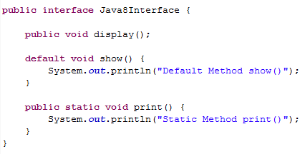
Interface
Till Java 1.7, we can have only abstract method(s) inside an interface, but from Java 1.8 onwards we can have default and static methods along with abstract method(s).
Default Method
A Method declared with ‘default’ access specifier.
Implemented class may override.
Removes the ambiguity in case multiple inheritance.
Static Method
A Method declared with ‘static’ keyword.
Can be called using the interface only.
Implemented class cannot override.
If overridden, creates a new definition.
Default and Static methods are concrete method, not abstract.

Slide 5
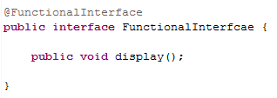
Functional Interface
An interface having at most one abstract method.
@FunctionalInterface annotation can be used.
@FunctionalInterface prevents further modifications in future.
Has the capability to hold the value of Lambda Expression.
Definition : An Interface having at most one abstract method and zero or one or more than one concrete (default, static) method is called Functional Interface.

Slide 6
Lambda Expression
What is Lambda Expression?
One of the important feature of Java 8.
Replacement of anonymous inner class.
Basically a function, which gives functional programming benefits.
Has the capability to return a method/behavior as a variable which can be passed to another method or lambda expression.
Helps to write more readable, maintainable and concise code.
Helps to use APIs very easily and effectively.
Enables parallel processing.
LISP (List Processing) is the first programming language which uses Lambda Expression.
Other Languages : C, C++, Objective C, C# .NET, SCALA, Ruby, Python.

Slide 7
Lambda Expression
How to write lambda expression?
Case 1: Method inside functional interface does not accept any parameter.
FunctionalInterfaceName referenceVariable = () -> { piece of code needs to be executed}
Invoking the lambda expression: referenceVariable .methodName();
Case 2: Method inside functional interface accepts parameter. Let’s assume it accepts two Strings as parameters.
FunctionalInterfaceName referenceVariable = (String s1, String s2) -> { piece of code needs to be executed}
Invoking the lambda expression: referenceVariable .methodName(s1, s2);
* In general { } contains the body of the method.
* For single line of code { } is not required.

Slide 8
Lambda Expression – Type Inference
Case 2: Method inside functional interface accepts parameter. Let’s assume it accepts two Strings as parameters.
FunctionalInterfaceName referenceVariable = (String s1, String s2) -> { piece of code needs to be executed}
Invoking the lambda expression: referenceVariable .methodName(s1, s2);
For this case, when the lambda expression is being defined, you can remove the type of the parameters as the expression gets this information from the method declared inside the functional interface by inferring it and hence this concept is known as Type Inference.
FunctionalInterfaceName referenceVariable = (s1, s2) -> { piece of code needs to be executed}
Invoking the lambda expression: referenceVariable .methodName(s1, s2);

Slide 9
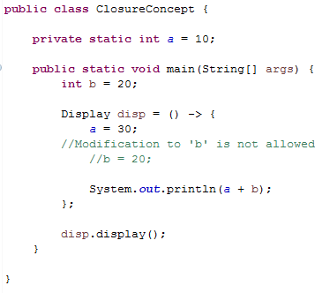
Lambda Expression – Closure
Lambda Expression can access both class variables and local variables.
Modification to any local variable is not allowed inside Lambda Expression since it becomes final in it's declaration when it is being used inside Lambda Expression.
But it can modify class variables.
Prevention to modification of local variable is known as Closure as the value gets frozen inside Lambda Expression.

Slide 10
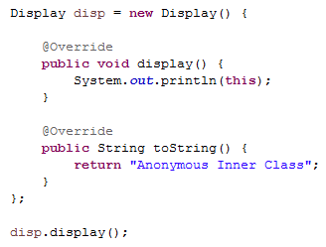
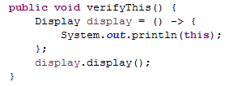
Lambda Expression – ‘this’ keyword
Inside anonymous inner class 'this' refers to the object of itself where as inside Lambda Expression
'this' refers to the current class. Which means anonymous class creates an object of the interface where as Lambda Expression does not create any object instead it refers to the class inside which it is being created, but the return value by Lambda Expression behaves like an instance.

Slide 11
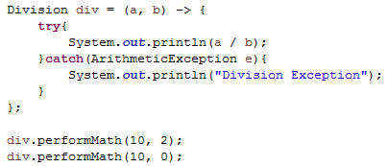
Lambda Expression – Exception Handling
As you can write the body of a method while writing the lambda expression, you can handle the exception inside lambda expression as well instead of handling outside.

Slide 12

Function Package
Java 8 by default provides some functional interfaces.
java.util.function
Some of them are :
Predicate<T> : boolean test(T t)
Consumer<T> : void accept(T t)
Function<T, R> : R apply(T t)
Supplier<T> : T get()
BiConsumer<T, U> : void accept(T t, U u)

Slide 13
Method Reference
Simplified (short-hand) form of Lambda Expression.
Uses double colon (::) operator.
Specifies the ClassName or InstanceName followed by the MethodName.
Example :
InstanceName::MethodName → System.out :: println
Types of Method Reference :
Static Method Reference
Constructor Method Reference
Instance Method Reference of an existing object
Instance Method Reference of an existing object of a particular type

Slide 14
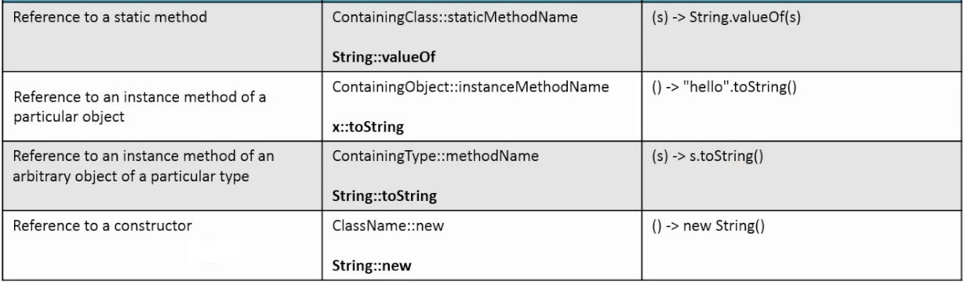
Method Reference

Slide 15


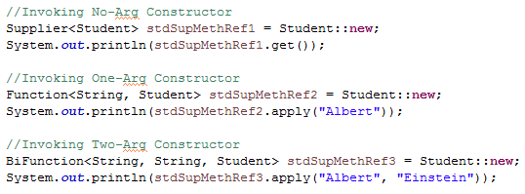
Method Reference
1. Static Method Reference
2. Instance Method Reference of an existing object
3. Instance Method Reference of an existing object of a particular type
4. Constructor Method Reference

Slide 16
Stream API
Enables bulk operations on Collection.
Helps to achieve parallel processing.
Definition : A sequence of elements supporting sequential and parallel aggregate operations.
java.util.stream package

Slide 17
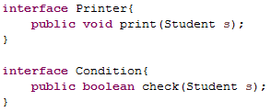
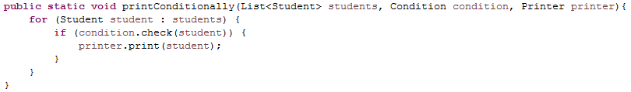
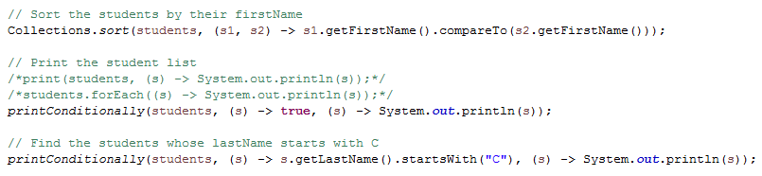
Stream API
Let’s assume that you have a list of Students and you want to perform the following operations.

Slide 18
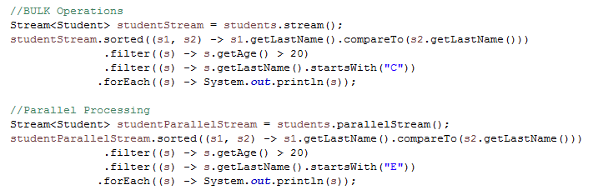
Stream API
Parallel streams divide the provided task into many and run them in different threads, utilizing multiple cores of the computer. On the other hand sequential streams work just like for-loop using a single core.
The tasks provided to the streams are typically the iterative operations performed on the elements of a collection or array or from other dynamic sources. Parallel execution of streams run multiple iterations simultaneously in different available cores.

Slide 19
Stream API
All Stream operations are divided into intermediate and terminal operations and are combined to form stream pipelines.
A stream pipeline consists of a source (such as a Collection, an array, a generator function, an I/O channel, or infinite sequence generator); followed by zero or more intermediate operations and a terminal operation.
Intermediate operations are not executed until some terminal operation is invoked.
They’re composed forming a pipeline of Stream execution. The intermediate operation can be added to a Stream pipeline by methods.
All Intermediate operations are lazy, so they’re not executed until a result of a processing is actually needed.
Basically, intermediate operations return a new stream.
Terminal operations may traverse the stream to produce a result.
After the terminal operation is performed, the stream pipeline is considered to be consumed, and can no longer be used. In almost all cases, terminal operations are eager, completing their traversal of the data source and processing of the pipeline before returning.

Slide 20
Stream API
Methods for Intermediate Operations:
filter()
map()
flatMap()
distinct()
sorted()
peek()
limit()
skip()
Methods for Terminal Operations:
forEach()
forEachOrdered()
toArray()
reduce()
collect()
min()
max()
count()
anyMatch()
allMatch()
noneMatch()
findFirst()
findAny()

Slide 21
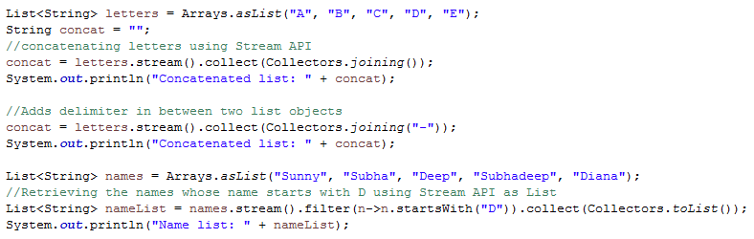
Stream API
The Collectors Class

Slide 22
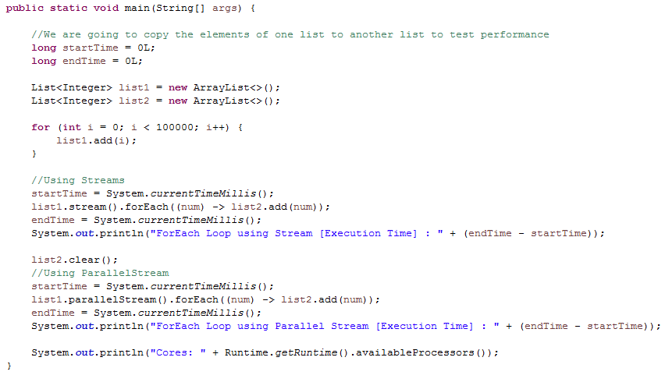
Stream API
Performance Testing: Stream Vs. ParallelStream

Slide 23
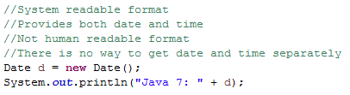
Date Time API
Till Java 7, We used to use Date and Time classes for creating date and time from java.util or java.sql package. Different classes provide different format [sql-> Database format, util-> System format] which create confusions.
Java 8 provides a new Date and Time API inside java.time package in a simpler way.

Slide 24
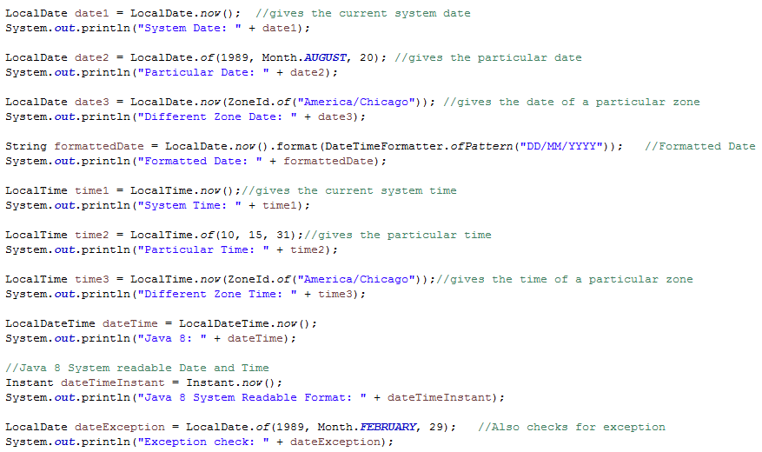
Date Time API

Slide 25
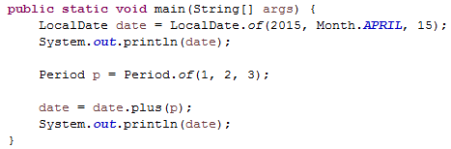
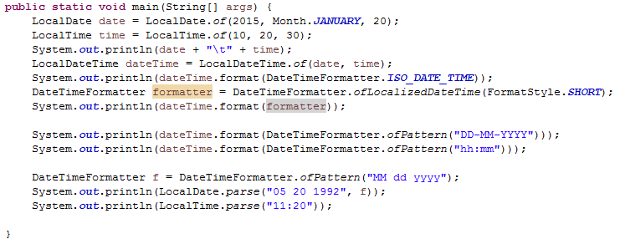
Date Time API
Period Class
Date Time Formatter

Slide 26
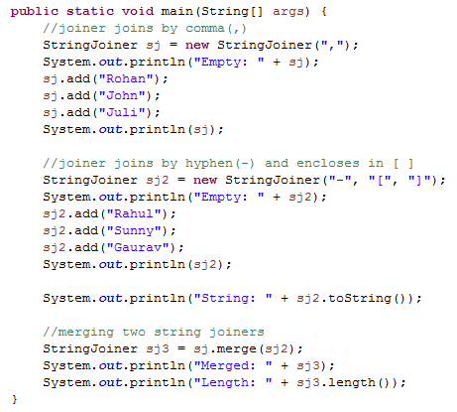
StringJoiner Class

Slide 27
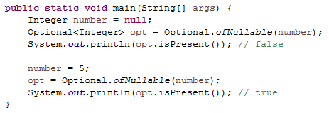
Optional Class
Null checks are not required.
No more NullPointerException at run-time.
We can develop clean and neat APIs.
No more Boiler plate code

Slide 28
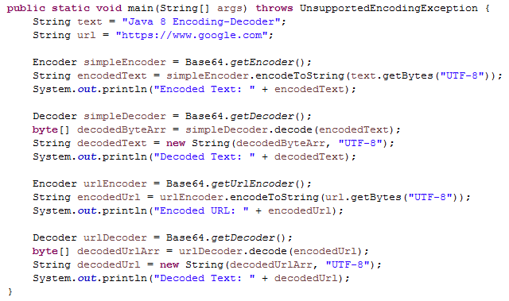
Base64 Class
It has three types of encoding and decoding: Simple Encoding, URL Encoding and MIME Encoding
For every type of encoder and decoder there is a specific class for getting the corresponding object

Slide 29

Nashorn Javascript Engine
With Java 8, Nashorn, a much improved javascript engine is introduced, to replace the existing Rhino.
Nashorn provides better performance, as it directly compiles the code in memory and passes the bytecode to JVM.
The Nashorn javascript engine can either be used programmatically from java programs or by utilizing the command line tool jjs, which located in JAVA_HOME/bin

Slide 30
Code
Visit to the following link for Examples on Java 8 New Features.
https://github.com/SubhadeepSen/Core-Java/tree/master/Java-8-New-Features

Slide 31
Thank You

